Slide 1

The Best Programming Languages
ricky brown, Hamid nahli, jesse law, Mimi Southwood, Nichelle garvey
It 115, group 2
SPRING 2022
Notes:
RICKY

Slide 2
Team Recommendations
HTML – Ricky Brown
CSS – Nicole Garvey
JavaScript – Jesse Law
SQL – Mimi Southwood
Python – Hamid Nahli
We will each mention the programming language we recommend during the course of the presentation.
Notes:
RICKY

Slide 3
JESSE - How did you change Code Compare?
GitHub -> Code Compare
READ.ME
CONTRIBUTING.md
license
index.html
styles.css
plan.html
survey research and repo
Powerpoint presentation
Notes:
JESSE

Slide 4
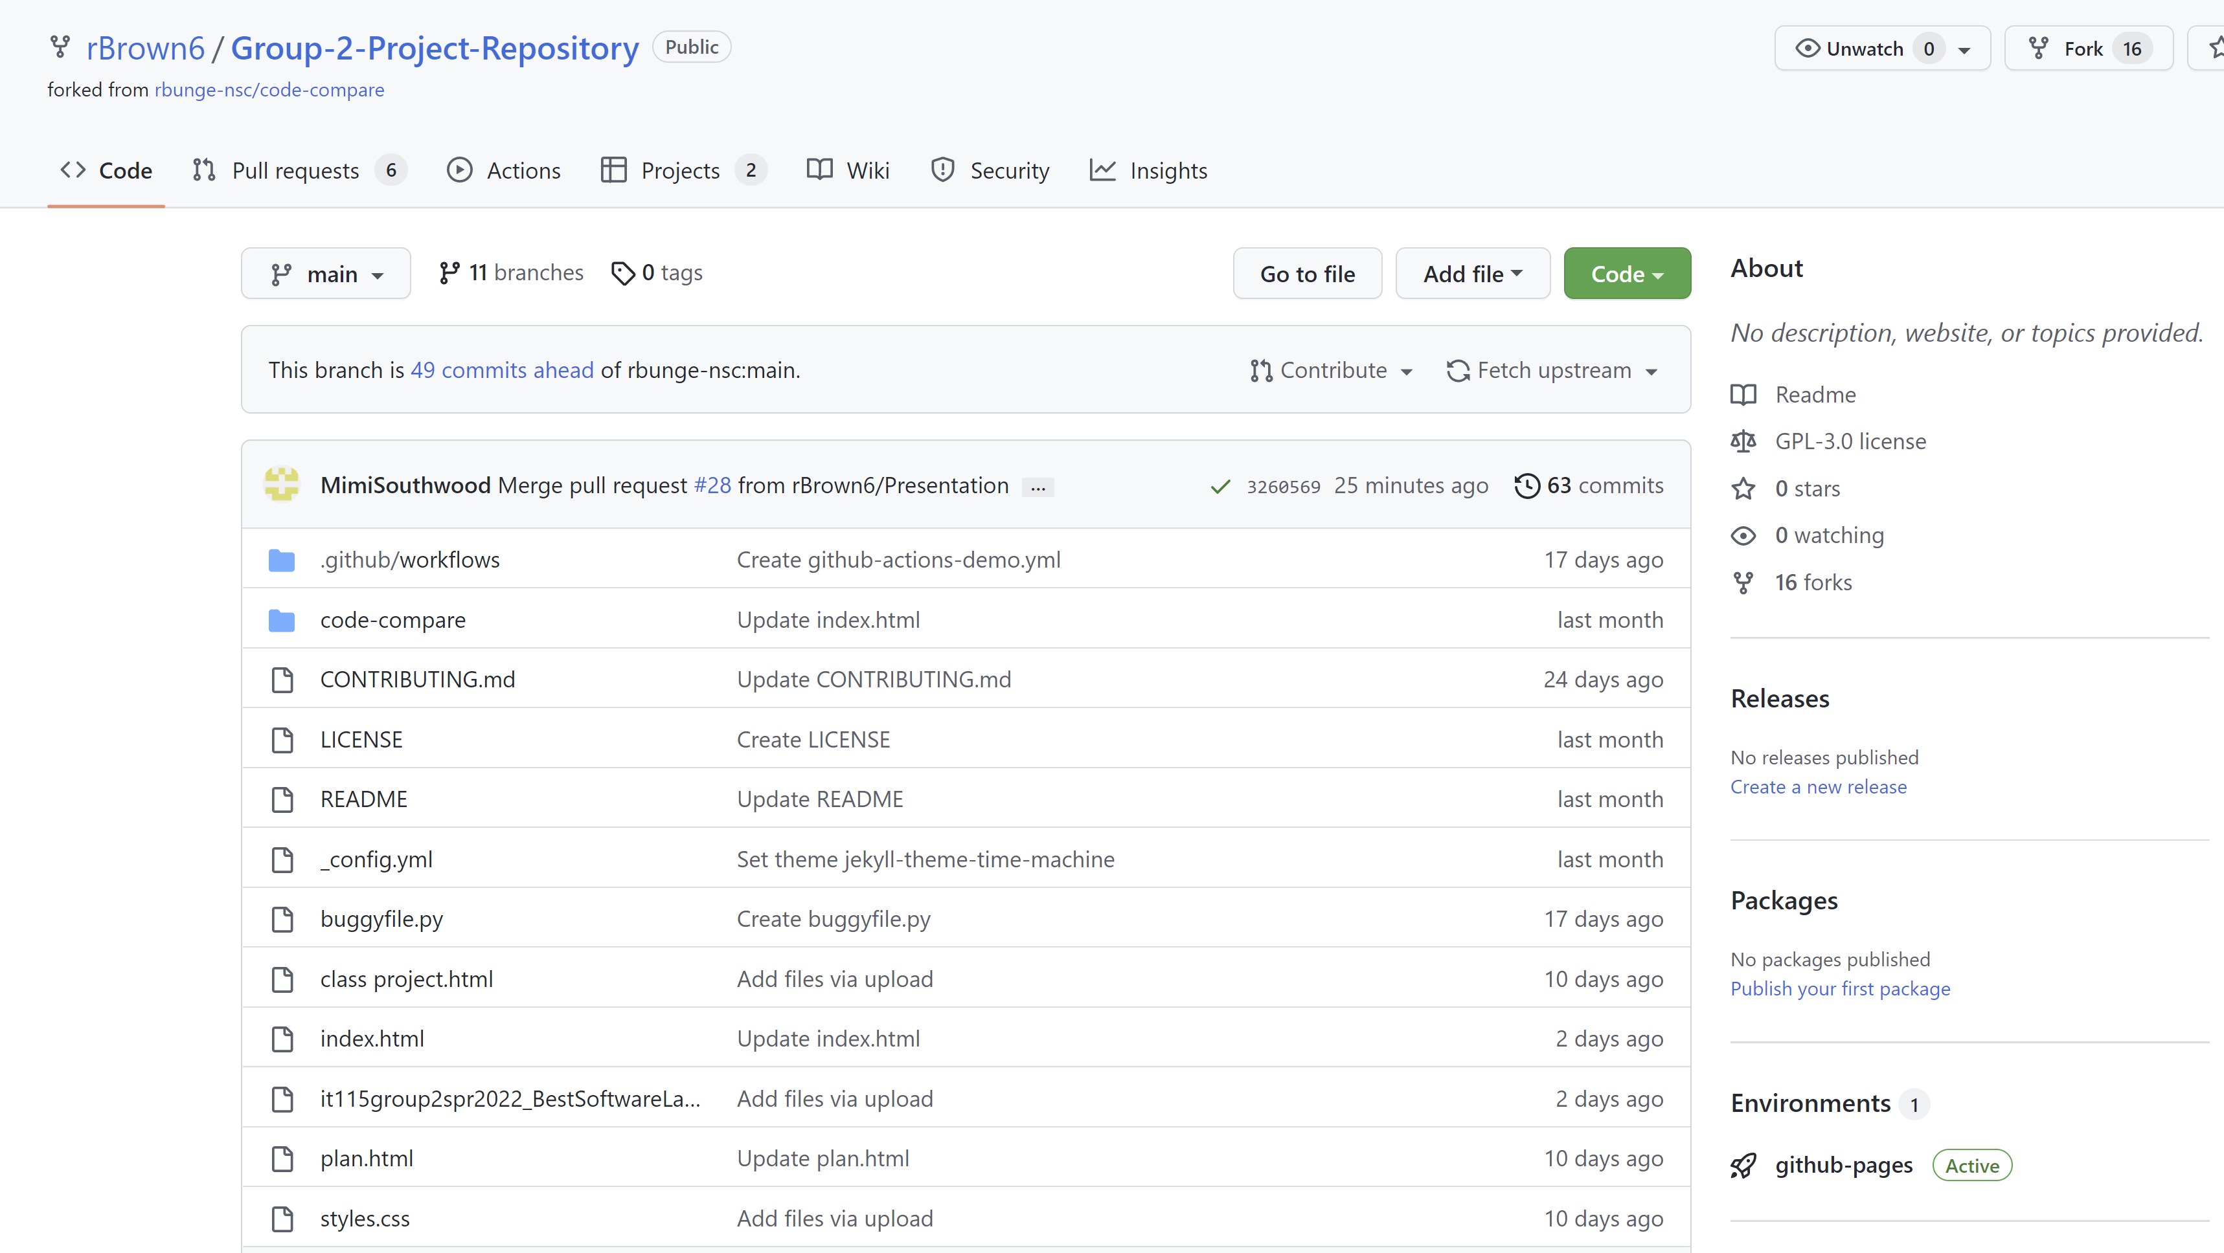
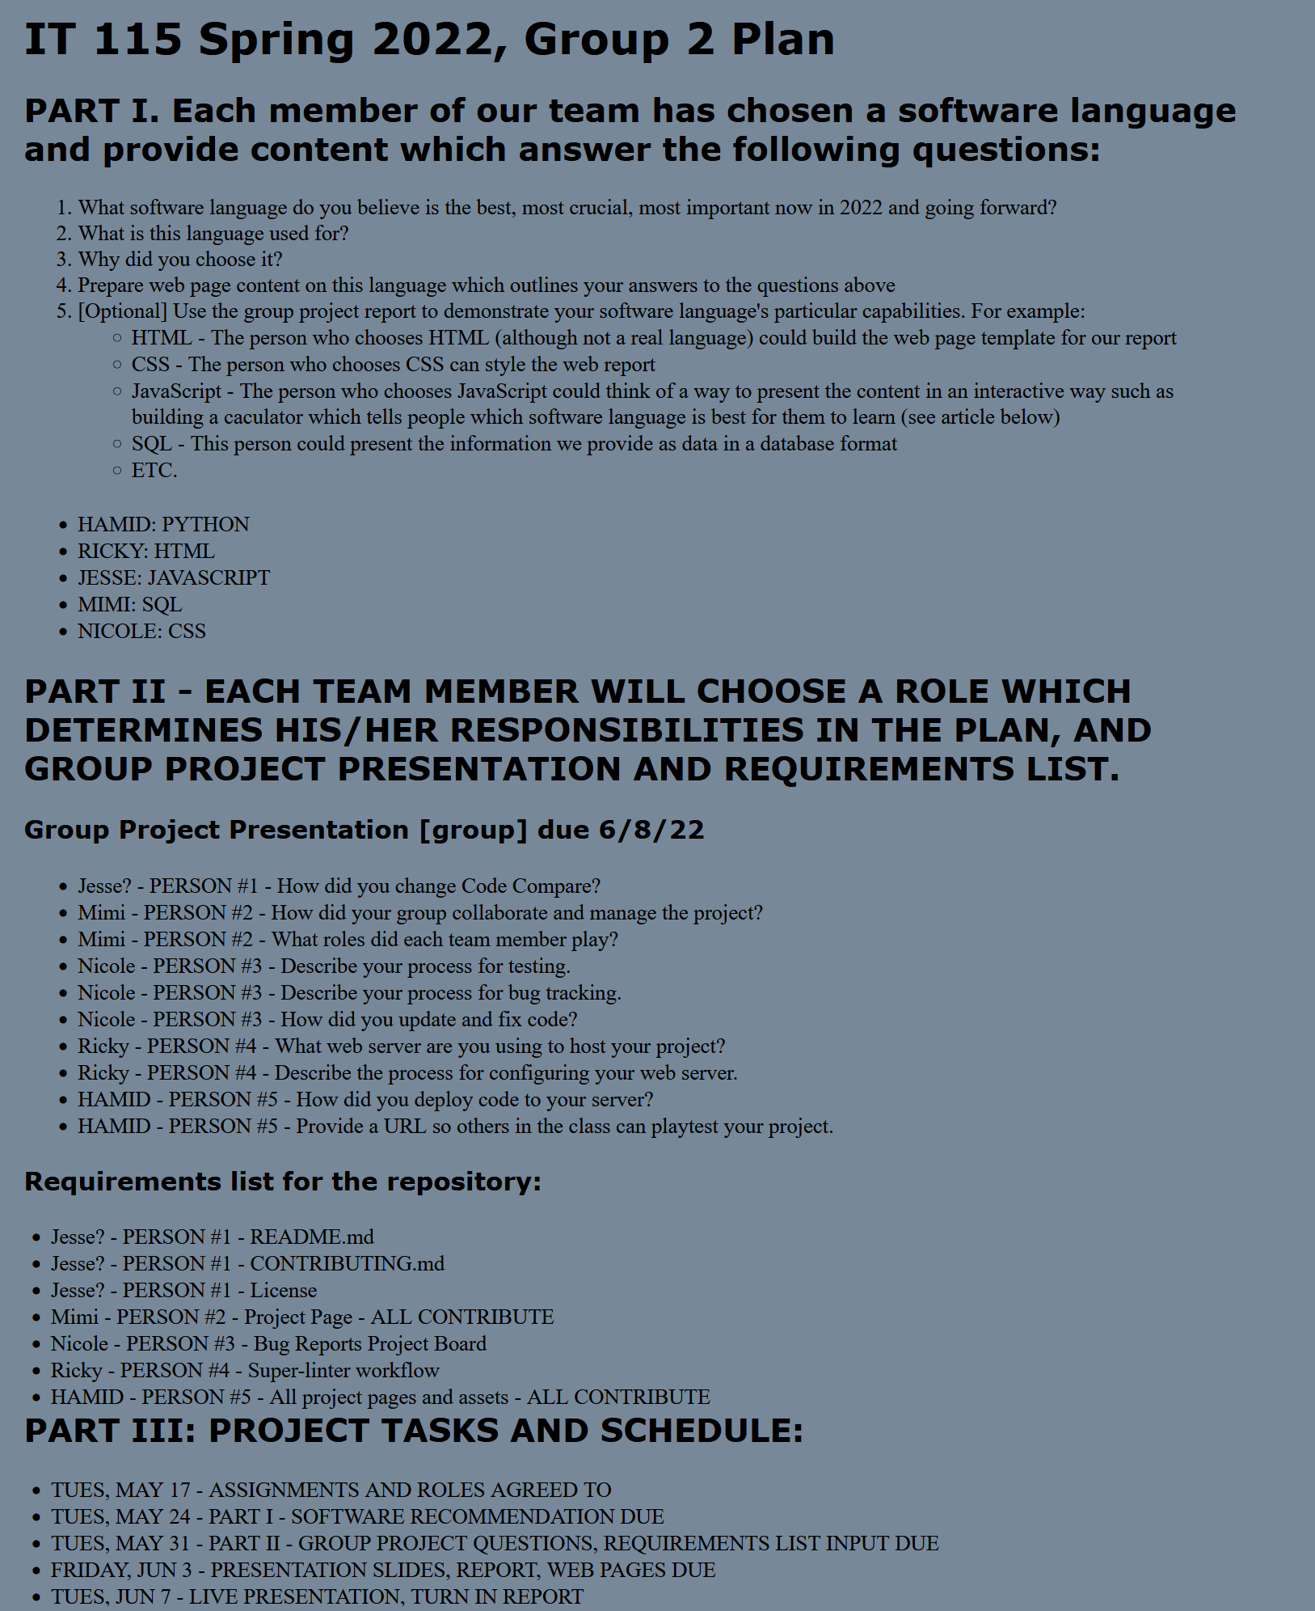
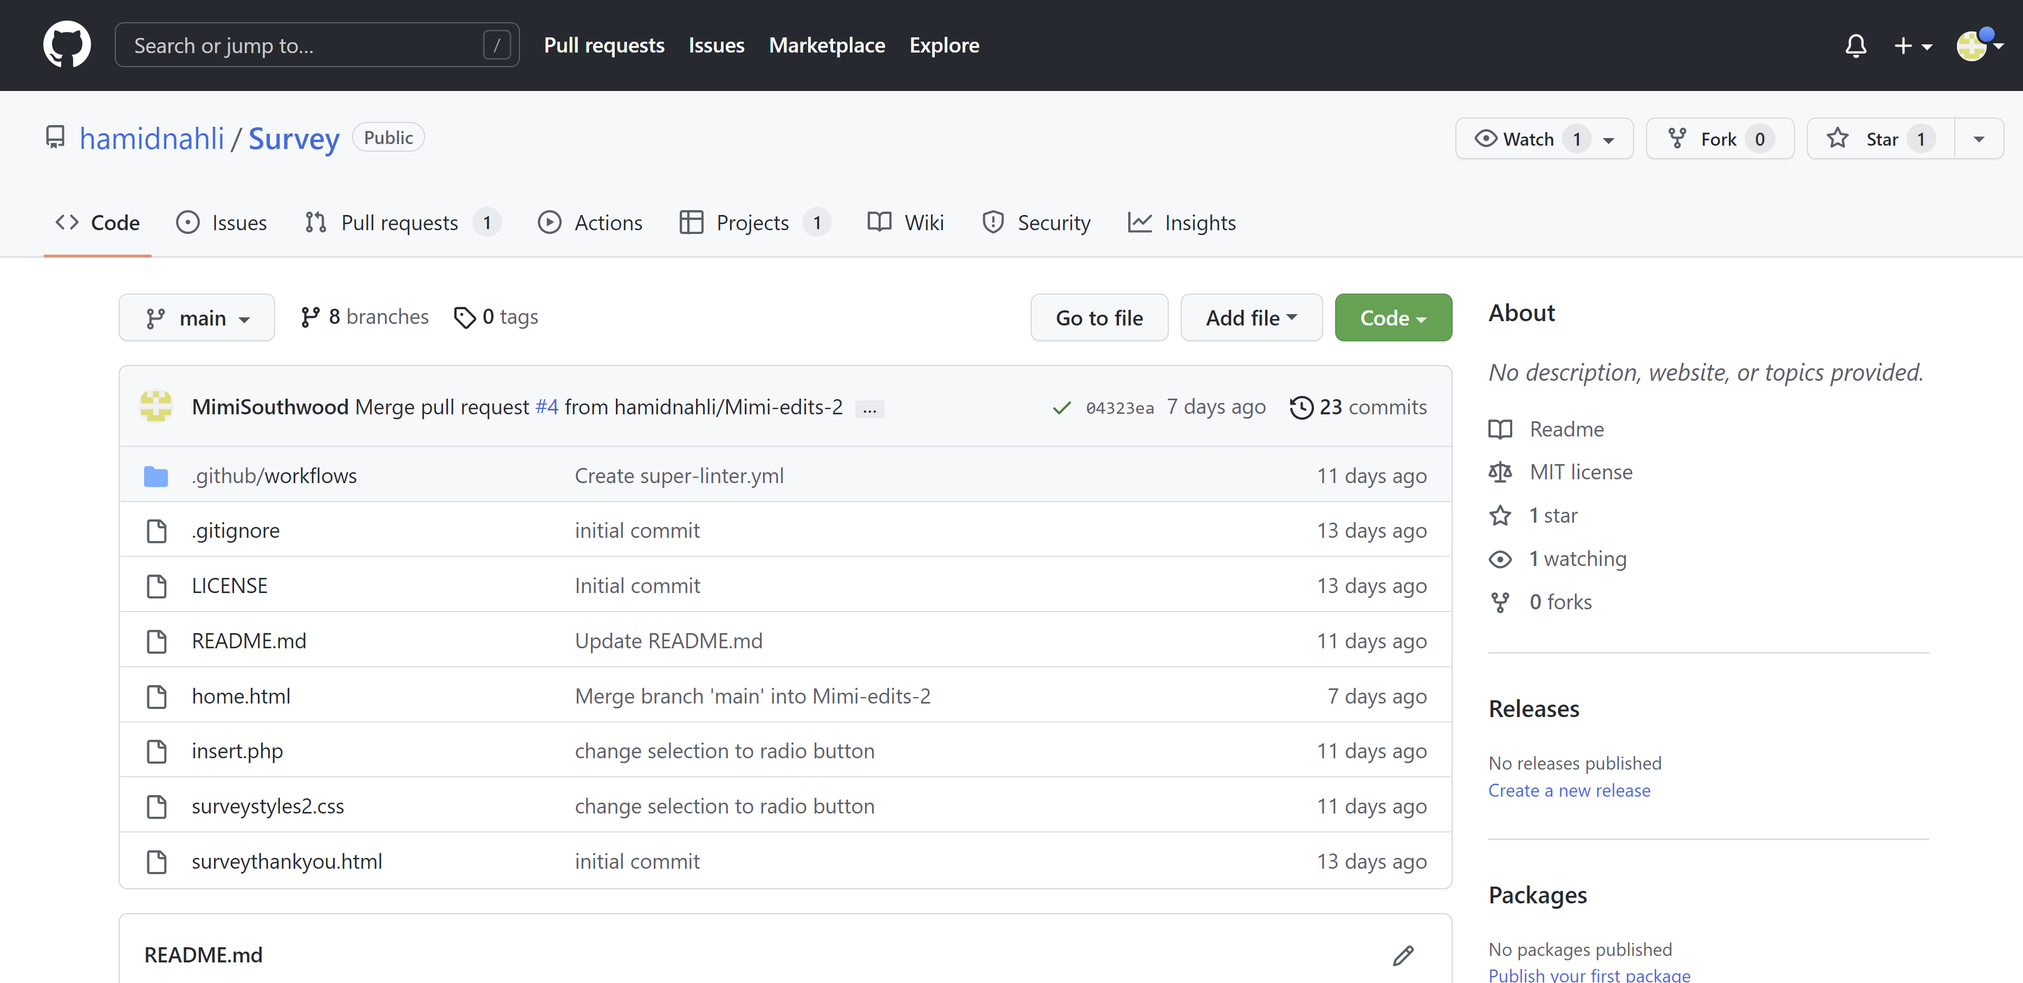
Team Collaboration, Project Management, Roles
Collaboration
GitHub – files, code updates
Email – communication
Project management, deliverables, roles – plan.html
Public content on project page
Project page - index.html, styles.css
Survey – separate repo, MySQL data files
Notes:
MIMI

Slide 5
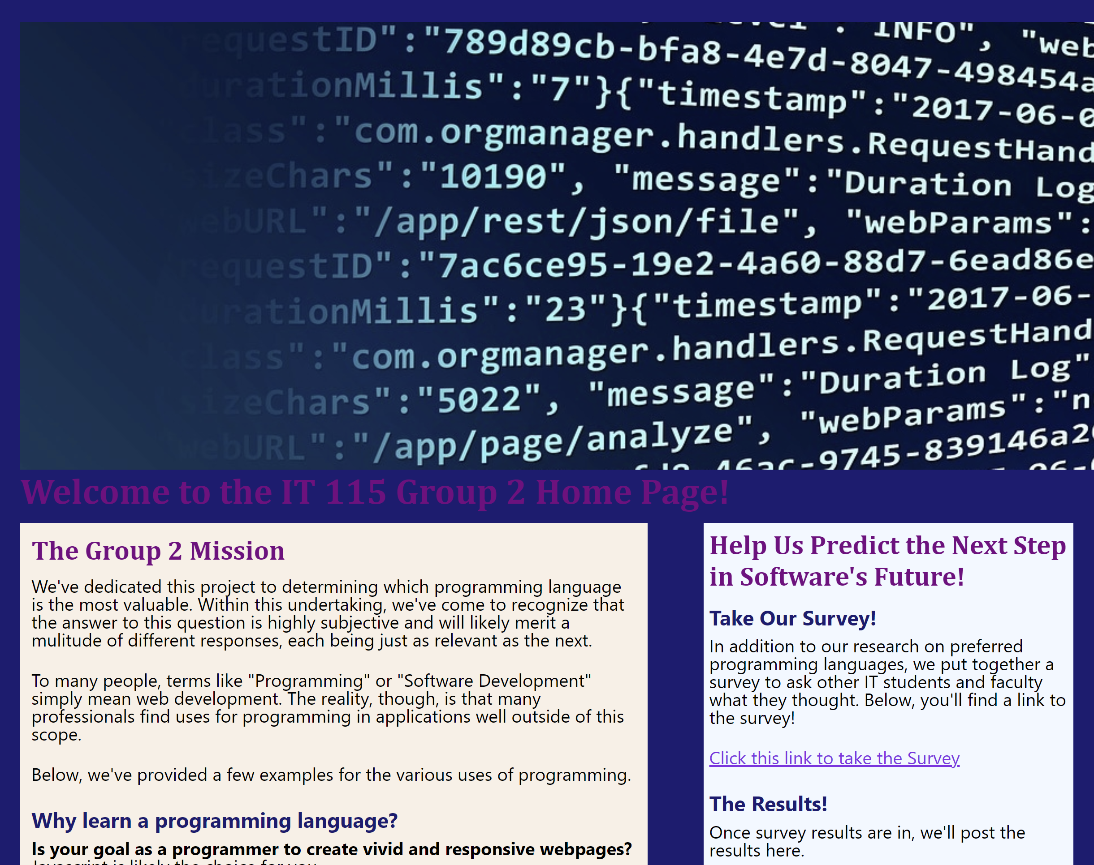
MIMI – Project Page, Public Content
Team Contributions
Mission
Team language choices
Language survey – results will be shared at the end of our presentation
Notes:
MIMI

Slide 6
NICOLE – Testing, Bug Tracking, and Updating and Fixing Code
4. Bug reports project board
Notes:
NICHELLE

Slide 7
NICOLE – Bug reports project board
Notes:
NICHELLE

Slide 8


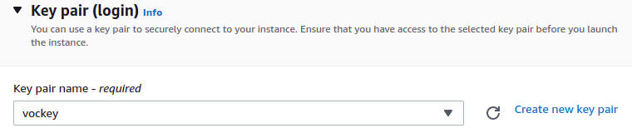
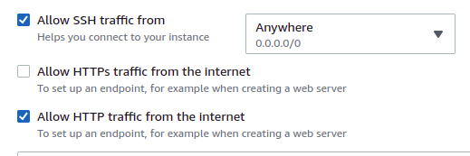
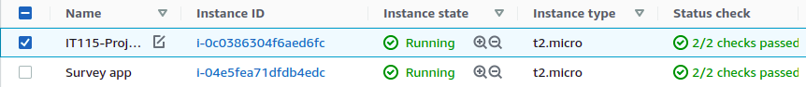
Web Server Hosting
We chose to use two separate AWS EC2 instances to host the web content for both our general project page and our Survey application.
The servers were configured using the free Ubuntu 20.04 version, and connected via SSH using a new key pair created with the included tool.
In Network Settings, we enabled traffic from SSH in order to connect remotely to the server using PuTTY, and HTTP for use as a public server
Finally, we can see our two instances running without issue.
Notes:
RICKY

Slide 9
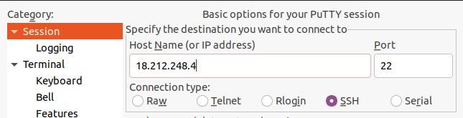
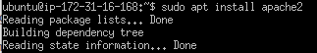



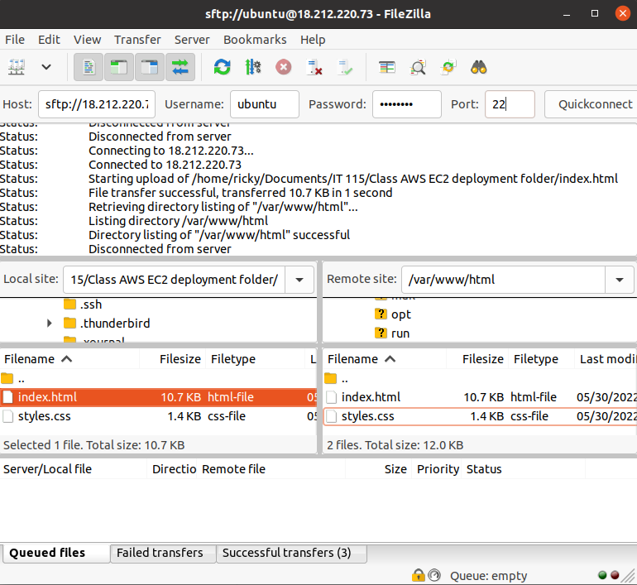
Web Server Configuration
To connect to our newly configured instances, we connected via PuTTY using our newly created SSH key pair.
Once in, we ran an update and installed Apache2 as our web server. Now our instances' Public IPv4 addresses were the host addresses for our servers.
In order to get our webpage and application files onto the servers, we used FileZilla.
Once our required files had been moved into the /var/www/html directory in the instance, our webpage and application content was up and running!
Notes:
RICKY

Slide 10
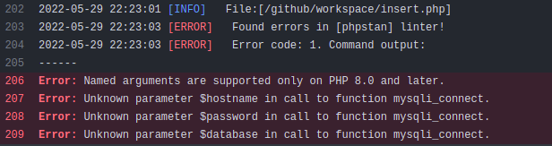
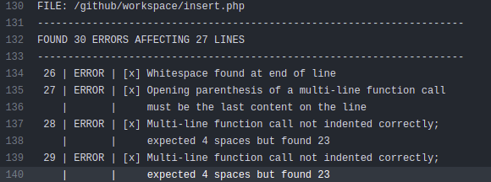
Super-Linter Workflow
Super-Linter showed its usefulness when it came to creating the survey part of our project, particularly within building the back-end elements. The application worked by tying an HTML front end framework together with a MySQL database server that existed on our AWS EC2 instance, using PHP as the business layer. With none within our group having any experience using PHP, an automated testing tool like Super-Linter was helpful. Though It certainly cannot serve as a stand-in for lack of programming knowledge.
Notes:
RICKY

Slide 11
HAMID – Deploying Code to the Server, URL for Testing
Notes:
HAMID

Slide 12
HAMID / RICKY – Summary of Project Pages, Assets
Notes:
HAMID

Slide 13
HAMID – Deploying Code to the Server, URL for Testing
Basic Requirements & Setup
A virtual server
A Web Server
A Databse management System
PHP v8.2
Notes:
HAMID

Slide 14
HAMID – Deploying Code to the Server, URL for Testing
Deployment
Final Deliverable:
http://107.21.5.253/
Clone the project git repo to the virtual server.
Create an SSH key to authenticate with Github
Pull - Repeat
Notes:
HAMID

Slide 15
Our Survey: Which Programming Languages Are Most Important?
Results
The top 5 for “today”: HTML, CSS, (Tableau), Python, JavaScript, C#
The top 5 for “in 5 years”: (Tableau), Python, JavaScript, Java, SQL, NoSQL
Python, Rust, Perl, (and Tableau) had greater scores “in 5 years,” than “today”
Note: The scores for “today” were higher on average at 3.46 vs “in 5 years” with 3.01
Notes:
HAMID

Slide 16
Our Survey: Which Programming Language Is Most Important?
Detail
Most growth predicted: Java, SQL and NoSQL all +4 (see
Biggest drops predicted: HTML, -11; CSS, -5, C# -5
Rank | Today | Avg
1 | HTML | 4.15
2 | CSS | 4
(2 write-in) | Tableau | 4
3 (tie) | Python | 3.92
3 (tie) | JavaScript | 3.92
5 (tie) | C# | 3.76
5 (tie) | Go | 3.76
7 | Java | 3.61
8 (tie) | SQL | 3.46
8 (tie) | NoSQL | 3.46
10 (tie) | Perl | 2.69
10 (tie) | Rust | 2.69
11 | Other | 2.07
Rank | In 5 Years | Avg
(1 write-in) | Tableau | 5
1 | Python | 4.15
2 | JavaScript | 3.46
3 (tie) | Java | 3.30
3 (tie) | SQL | 3.30
5 | NoSQL | 3.07
6 (3-way tie) | CSS | 3
6 (3-way tie) | Go | 3
6 (3-way tie) | Rust | 3
9 | Perl | 2.84
10 | C# | 2.76
11 | HTML | 2.61
12 | All Other | 1.61
Over 5 Years | Change
Tableau | "+2"
Python | "+2"
JavaScript | "+2"
Java | "+4"
SQL | "+4"
NoSQL | "+4"
CSS | "-5"
Go | "-1"
Rust | "+3"
Perl | "+1"
C# | "-5"
HTML | "-11"
All Other | No change
Notes:
HAMID

Slide 17
Thank you!
Notes:
RICKY, ALL

